Slide 1
Software Development Life Cycle (SDLC)
“You’ve got to be very careful if you don’t know where you’re going, because you might not get there.”

Slide 2
SDLC Model
A framework that describes the activities performed at each stage of a software development project.

Slide 3
predictive and adaptive approaches
Predictive assumes requirements are defined and static. Adaptive acknowledges uncertainty with a flexible and adaptable approach to cope with it.
In Predictive strategy, / Plan Driven
a precise plan is created and adhered to throughout the duration of the project. The timetable, budget, and deliverables are all specified and determined from the beginning of the project. This method is ideal for projects with well-defined needs and stable environments.
Agile is a flexible, adaptive approach to software development that emphasizes collaboration, customer involvement, and rapid delivery of working software. Agile teams work in short sprints, delivering incremental releases of the software and regularly incorporating feedback from stakeholders. sequential and linear process.

Slide 4
Main Methodologies Used in Software Engineering
Software Engineering uses various methodologies to plan, design, develop, test, and maintain software efficiently. The main methodologies are:
Waterfall Model:
A linear and sequential model where each phase (requirement, design, implementation, testing, deployment) must be completed before the next begins. Suitable for small and well-defined projects.
Agile Methodology:
An iterative and incremental approach focusing on flexibility, customer collaboration, and fast delivery. Common frameworks include Scrum and Kanban. Suitable for dynamic and evolving projects.
Spiral Model:
Combines iterative development with risk analysis. Software is developed in repeated cycles (spirals), allowing for refinement and risk management at each stage.
Incremental Model :Incremental Model is a process of software development where requirements are broken down into multiple standalone modules of software development cycle.

Slide 5
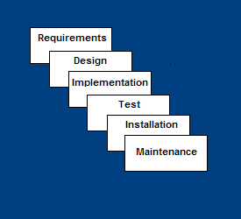
Waterfall Model
Requirements – defines needed information, function, behavior, performance and interfaces.
Design – data structures, software architecture, interface representations, algorithmic details.
Implementation – source code, database, user documentation, testing.

Slide 6
Test
The development team combines automation and manual testing to check the software for bugs. Quality analysis includes testing the software for errors and checking if it meets customer requirements. Because many teams immediately test the code they write, the testing phase often runs parallel to the development phase.

Slide 7
Deploy
When teams develop software, they code and test on a different copy of the software than the one that the users have access to. The software that customers use is called production, while other copies are said to be in the build environment, or testing environment.
Having separate build and production environments ensures that customers can continue to use the software even while it is being changed or upgraded. The deployment phase includes several tasks to move the latest build copy to the production environment, such as packaging, environment configuration, and installation.

Slide 8
Maintain
In the maintenance phase, among other tasks, the team fixes bugs, resolves customer issues, and manages software changes. In addition, the team monitors overall system performance, security, and user experience to identify new ways to improve the existing software.

Slide 9
Waterfall Strengths
Easy to understand, easy to use
Provides structure to inexperienced staff
Milestones are well understood
Sets requirements stability
Good for management control (plan, staff, track)
Works well when quality is more important than cost or schedule

Slide 10
Waterfall Deficiencies
All requirements must be known upfront
Deliverables created for each phase are considered frozen – inhibits flexibility
Can give a false impression of progress
Does not reflect problem-solving nature of software development – iterations of phases
Integration is one big bang at the end
Little opportunity for customer to preview the system (until it may be too late)

Slide 11
When to use the Waterfall Model
Requirements are very well known
Product definition is stable
Technology is understood
New version of an existing product
Porting an existing product to a new platform.

Slide 12
Incremental Model
Incremental Model is a process of software development where requirements are broken down into multiple standalone modules of software development cycle.
Each iteration passes through the requirements, design, coding and testing phases.
Typical product takes from 5 to 25 builds (iterations).

Slide 13
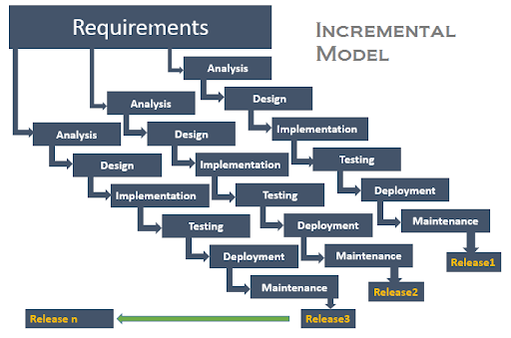
Incremental Model (contd.)

Slide 14
Incremental Model (contd.)
Waterfall and rapid prototyping models
  Deliver complete product at the end
Incremental model
  Deliver portion of the product at each stage
Advantages
  The software will be generated quickly during the software life cycle
  It is flexible and less expensive to change requirements and scope
  Throughout the development stages changes can be done
  This model is less costly compared to others
  A customer can respond to each building
  Errors are easy to be identified

Slide 15
Incremental Model (contd.)
Disadvantages:
  It requires a good planning designing
  Problems might arise due to system architecture as not all requirements collected up front for the entire software lifecycle
  Each iteration phase is rigid and does not overlap each other
  Correcting a problem in one unit requires correction in all the units and consumes a lot of time

Slide 16
When to use Incremental models?
Requirements of the system are clearly understood
When demand for an early release of a product arises
When software engineering team are not very well skilled or trained
When high-risk features and goals are involved
Such methodology is more in use for web application and product based companies

Slide 17
Spiral Model
The spiral model is a risk-driven software development process model.
Based on the unique risk patterns of a given project, the spiral model guides a team to adopt elements of one or more process models, such as incremental, waterfall, or evolutionary prototyping.
Risk Analysis: Identification of potential risk is done while risk mitigation strategy is planned and finalized
Precede each phase by
  Alternatives
  Risk analysis
Follow each phase by
  Evaluation
  Planning of next phase
Notes:
Examples of Software Risks include:
1- Estimation and scheduling
2- Sudden growth in requirements
3- Employee turnover
4- Productivity issues
5- Compromising on designs
6- Technical risks

Slide 18
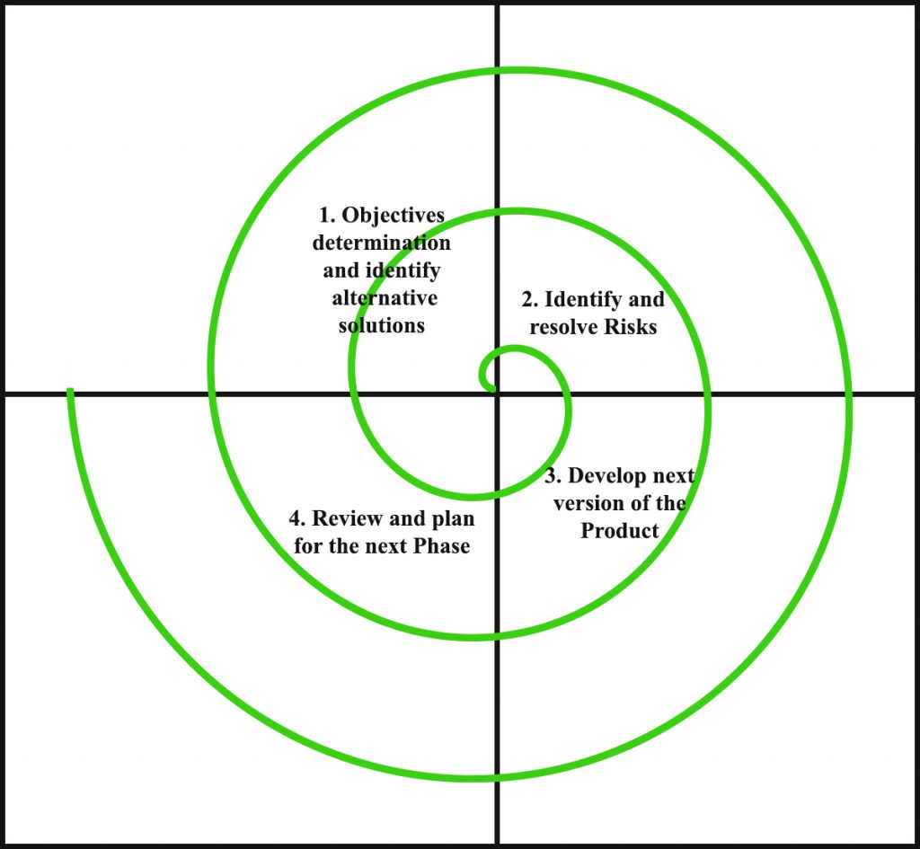
Simplified Spiral Model

Slide 19
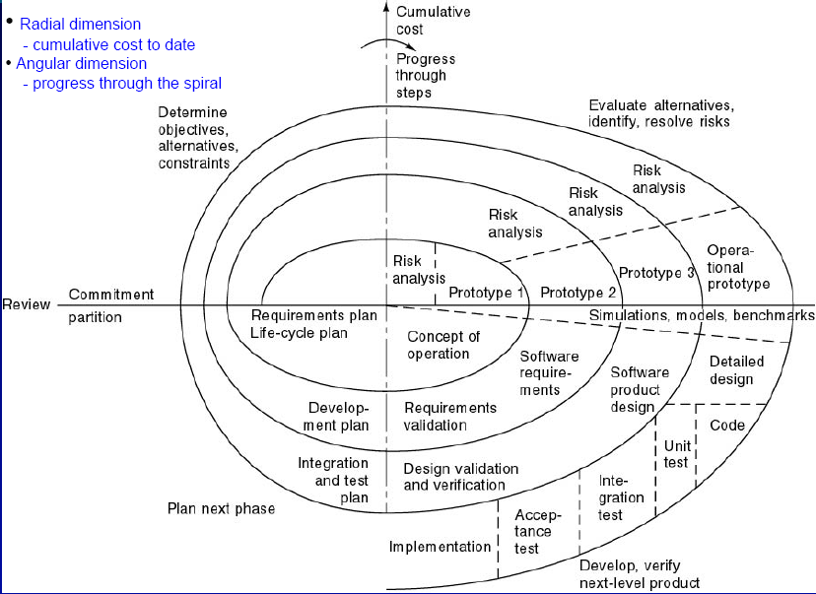
Full Spiral Model

Slide 20
When to use Spiral Methodology?
When project is large
When releases are required to be frequent
When creation of a prototype is applicable
When risk and costs evaluation is important
For medium to high-risk projects
When requirements are unclear and complex
When changes may require at any time
When long term project commitment is not feasible due to changes in economic priorities

Slide 21
Advantages of Spiral Model
Additional functionality or changes can be done at a later stage
Cost estimation becomes easy as the prototype building is done in small fragments
Continuous or repeated development helps in risk management
Development is fast and features are added in a systematic way
There is always a space for customer feedback

Slide 22
Disadvantages of Spiral Model
Risk of not meeting the schedule or budget
It works best for large projects only also demands risk assessment expertise
For its smooth operation spiral model protocol needs to be followed strictly
Documentation is more as it has intermediate phases
It is not advisable for smaller project, it might cost them a lot

Slide 23
Agile Process Models
Agile software engineering combines a philosophy and a set of development guidelines
Philosophy
  Encourages customer satisfaction and early incremental delivery of the software
  Small highly motivated project teams
  Informal methods
  Minimal software engineering work products
  Overall development simplicity
Development guidelines
  Stress delivery over analysis and design
  Active and continuous communication between developers and customers

Slide 24
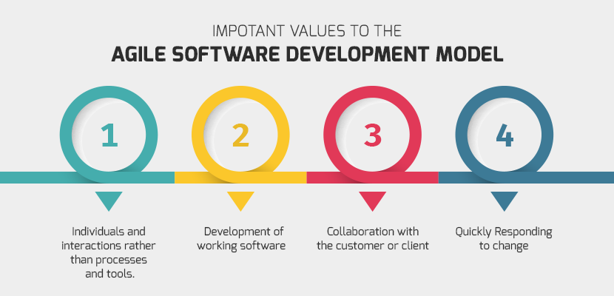
Agile Process Models (contd.)

Slide 25
Agile vs. Waterfall Method
Agile Model | Waterfall Model
Agile method proposes incremental and iterative approach to software design | Development of the software flows sequentially from start point to end point.
The agile process is broken into individual models that designers work on | The design process is not broken into an individual models
The customer has early and frequent opportunities to look at the product and make decision and changes to the project | The customer can only see the product at the end of the project
Agile model is considered unstructured compared to the waterfall model | Waterfall model are more secure because they are so plan oriented

Slide 26
Agile vs. Waterfall Method (contd.)
Agile Model | Waterfall Model
Small projects can be implemented very quickly. For large projects, it is difficult to estimate the development time. | All sorts of project can be estimated and completed.
Error can be fixed in the middle of the project. | Only at the end, the whole product is tested. If the requirement error is found or any changes have to be made, the project has to start from the beginning
Development process is iterative, and the project is executed in short (2-4) weeks iterations. Planning is very less. | The development process is phased, and the phase is much bigger than iteration. Every phase ends with the detailed description of the next phase.
Documentation attends less priority than software development | Documentation is a top priority and can even use for training staff and upgrade the software with another team

Slide 27
Agile vs. Waterfall Method (contd.)
Agile Model | Waterfall Model
In agile testing when an iteration end, shippable features of the product is delivered to the customer. New features are usable right after shipment. It is useful when you have good contact with customers. | All features developed are delivered at once after the long implementation phase.
Testers and developers work together | Testers work separately from developers
At the end of every sprint, user acceptance is performed | User acceptance is performed at the end of the project.
It requires close communication with developers and together analyze requirements and planning | Developer does not involve in requirement and planning process. Usually, time delays between tests and coding

Slide 28
Agile methodology
Agile methodology in software engineering is a project management approach that emphasizes flexibility, collaboration, and iterative development. It involves breaking down projects into smaller, manageable cycles called sprints, allowing teams to adapt to changes and deliver value incrementally

Slide 29
The key concepts of Agile development and Agile software development are:
1. Adaptability :The changing demands and development process require adaptability in the project. It helps the team and project get back on track, increases the team’s confidence, saves time, and decreases productivity due to mess. It also allows changing the development and deployment path to deliver timely results.
2. Collaboration
It is another valued key Agile concept that builds trust and accountability. It helps bring different ideas and collective discussion to improve poor but potentially holding ideas.
3.Iterative Developments
Rework for improvements is a common thing in software development. The iterative process here follows a continuous and close feedback loop for improvement. It is the core concept in Agile development.

Slide 30
What is the role of Quality Assurance in Software Engineering
Quality Assurance (QA) in Software Engineering ensures that the software product meets the required quality standards before delivery. It is a systematic process that involves:
Defining Standards and Procedures: QA sets up development and testing standards to ensure consistency and quality across the software lifecycle.
Process Monitoring: QA continuously monitors and audits the development process to identify deviations from standards and correct them early.
Defect Prevention: Instead of just detecting defects, QA focuses on preventing them by improving processes and training teams.
Improving Product Reliability: Through proper documentation, testing strategies, and reviews, QA helps deliver a reliable and maintainable product.
Suppose a company developing an online banking system. The Quality Assurance team sets coding standards, conducts code reviews, and performs testing at each stage (unit, integration, system testing).During QA reviews, they find that login module has no input validation, which could lead to security risks. Because QA identified this early, the developers fixed it before release.

Slide 31
Cs vs SE
Aspect | Computer Science (CS) | Software Engineering (SE)
Focus | Theoretical foundations of computation and algorithms. | Application of engineering principles to software development.
Core Areas | Algorithms, theory of computation, hardware, AI, etc. | Software design, development, testing, maintenance.
Approach | Scientific and mathematical approach. | Systematic, process-driven, and project-oriented.
Goal | To understand computation and solve abstract problems. | To build reliable, efficient, and maintainable software systems.

Slide 32
Prototyping Model is a way of developing software where an early version, or prototype, of the product is created and shared with users for feedback.
The Prototyping Model is one of the most popularly used SDLC models.This model is used when the customers do not know the exact project requirements beforehand.
In this model, a prototype of the end product is first developed, tested, and refined as per customer feedback repeatedly till a final acceptable prototype is achieved which forms the basis for developing the final product.

Slide 33
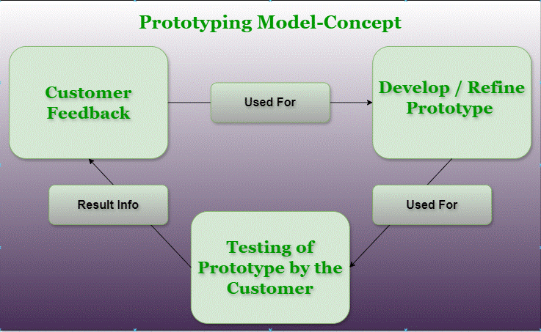

Slide 34
Prototyping allows designers to test the practicability of the current design and potentially investigate how trial users think and feel about the product. It enables proper testing and exploring design concepts before too many resources get used.

Slide 35
Suppose you are building an online ticket booking system.
You create a simple mock-up of the interface using basic HTML (no real backend).The user tries it and says, "I want to see available seat numbers before booking."
You adjust the prototype quickly to reflect that.
Once you finalize what the user really needs, you discard this prototype and build the real system with all proper features and architecture.
Fast and inexpensive.
Not part of the final product.
Helps clarify vague requirements early.

Slide 36
Evolutionary Prototyping
To develop a system where requirements are expected to evolve over time.
Consider you're developing a mobile app for personal finance tracking.
You start with a prototype that tracks only income and expenses.
Users begin using it and suggest adding budget planning, graphs, and reminders.
You keep adding features and refining the same system, without discarding the original prototype.
Eventually, the prototype grows into the complete application.

Slide 37
Mainly two types of Prototyping Models, which are described below.
1. Rapid Throwaway Prototyping
This technique offers a useful method of exploring ideas and getting customer feedback for each of them.
In this method, a developed prototype need not necessarily be a part of the accepted prototype.
Customer feedback helps prevent unnecessary design faults and hence, the final prototype developed is of better quality.
2. Evolutionary Prototyping
In this method, the prototype developed initially is incrementally refined based on customer feedback till it finally gets accepted.
In comparison to Rapid Throwaway Prototyping, it offers a better approach that saves time as well as effort.
This is because developing a prototype from scratch for every iteration of the process can sometimes be very frustrating for the developers.

Slide 38
Structured Evolutionary Prototyping Strengths
Customers can “see” the system requirements as they are being gathered.Developers learn from customers
Allows for flexible design and development
Steady, visible signs of progress produced
Interaction with the prototype stimulates awareness of additional needed functionalit
Tendency to abandon structured program development for “code-and-fix” development
Bad reputation for “quick-and-dirty” methods

Slide 39
When to use
Structured Evolutionary Prototyping
Requirements are unstable or have to be clarified
Develop user interfaces
Short-lived demonstrations
With the analysis and design portions of object-oriented development.

Slide 40
Spiral Model
The spiral model is a risk-driven software development process model.
Risk Analysis: Identification of potential risk is done while risk mitigation strategy is planned and finalized
Precede each phase by
  Alternatives
  Risk analysis
Follow each phase by
  Evaluation
  Planning of next phase
Notes:
Examples of Software Risks include:
1- Estimation and scheduling
2- Sudden growth in requirements
3- Employee turnover
4- Productivity issues
5- Compromising on designs
6- Technical risks

Slide 41
Simplified Spiral Model

Slide 42
Full Spiral Model

Slide 43
When to use Spiral Methodology?
When project is large
When releases are required to be frequent
When creation of a prototype is applicable
When risk and costs evaluation is important
For medium to high-risk projects
When requirements are unclear and complex
When changes may require at any time
When long term project commitment is not feasible due to changes in economic priorities

Slide 44
Advantages of Spiral Model
Additional functionality or changes can be done at a later stage
Cost estimation becomes easy as the prototype building is done in small fragments
Continuous or repeated development helps in risk management
Development is fast and features are added in a systematic way
There is always a space for customer feedback

Slide 45
Disadvantages of Spiral Model
Risk of not meeting the schedule or budget
It works best for large projects only also demands risk assessment expertise
For its smooth operation spiral model protocol needs to be followed strictly
Documentation is more as it has intermediate phases
It is not advisable for smaller project, it might cost them a lot

Slide 46
Questions??

